Slide 1
“Farming” for environmental solutions; or vice versa?
By: Tree Over Ate (TOA)

Slide 2
OUR TEAM:
Shaun Munshi
Pranav Srisankar
Shlok Mehrotra
Shubham Kumar

Slide 3
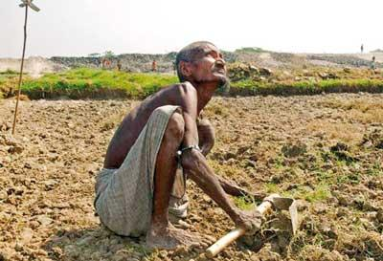
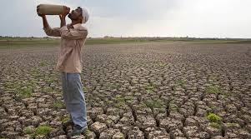
Background Information & Problem
-Guardians of the Connected World, Guardians of the agricultural world

Slide 4
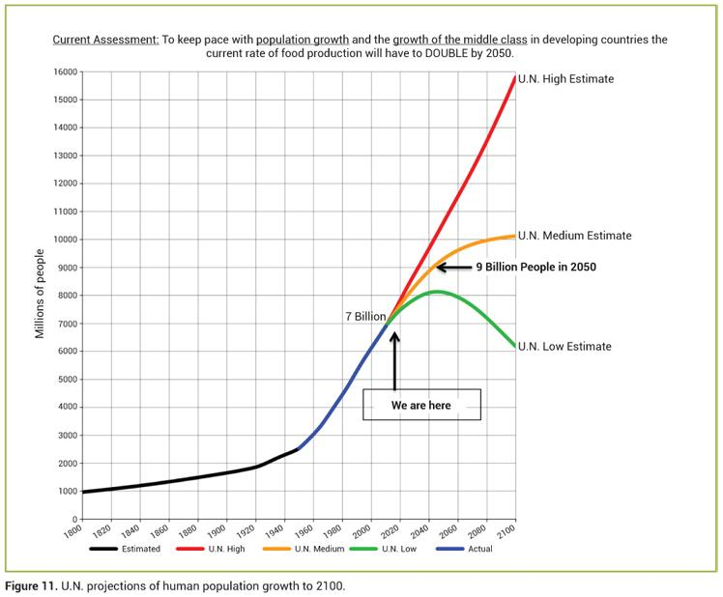
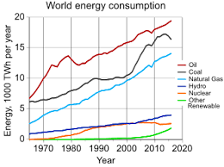
Sensor(Arduino) sends data to the application.
Transformation of Data
Final Outputs
The data is plotted as a graph, and predictions are formed using a simple algorithm.
The final measurements as well as predictions are exported as a graph. The farmers can now have faith in food on the table.
The sensors take data, and use electrical wiring to wire the signals to the microcontroller.

Slide 5


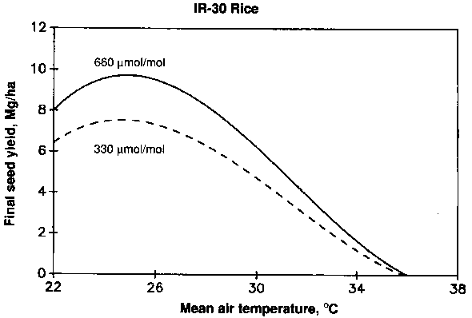
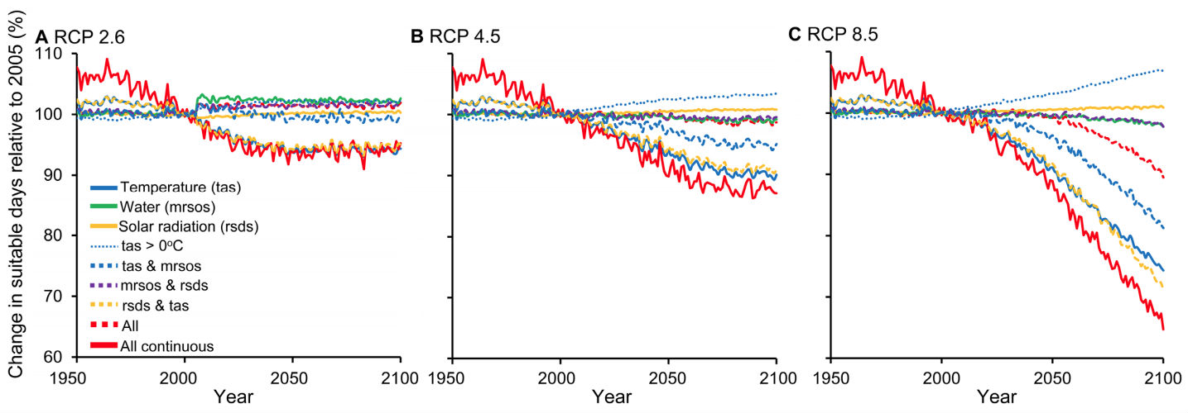
1. Temperature
How does Temperature affect farmers?
Unexpected Excess Temperature makes it harder for plants to transpire
Plants can die
Sensor checks for temperature in air, reports about the temp to the graph

Slide 6
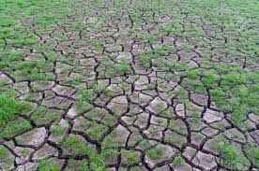
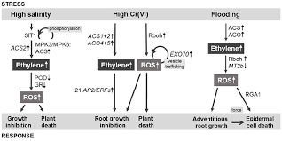
2. Moisture
Too little Moisture -plants don’t have enough water, tells the farmer to water the plants more
Too MUCH moisture -Plants can drown in water. If they don’t drown, root damage is immense, weakening the plants.

Slide 7
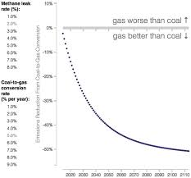
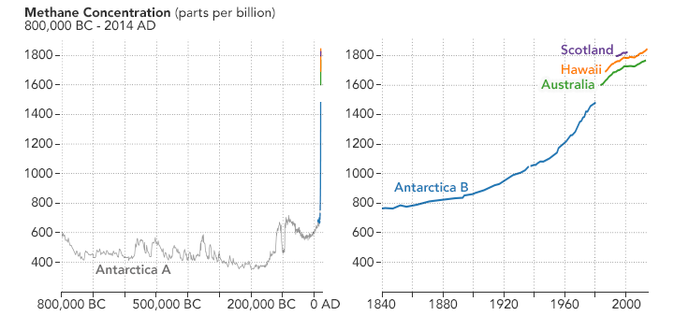
3. Gas
Can Gas really affect farming?
Underground Pipelines -gas leaks underground are responsible for killing plants.
Gas Sensor: With the gas sensor, we can predict whether farmers should plant their crops or not, saving them thousands of dollars.

Slide 8
SO WHY US?
PREDICTIONS!!!!
-some other companies have the same product
-sells for 400 dollars
-to cover a farm, costs 1 million dollars
-around 100 dollars with us

Slide 9
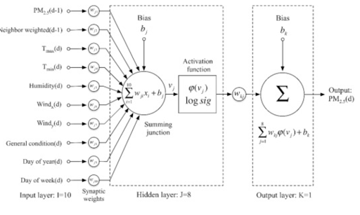
How are we going to predict?

Slide 10
How much of the world’s poor have farming as a job to support their family?

Slide 11
One third. Out of every three people, one of you would be a farmer in a 3rd world country.

Slide 12
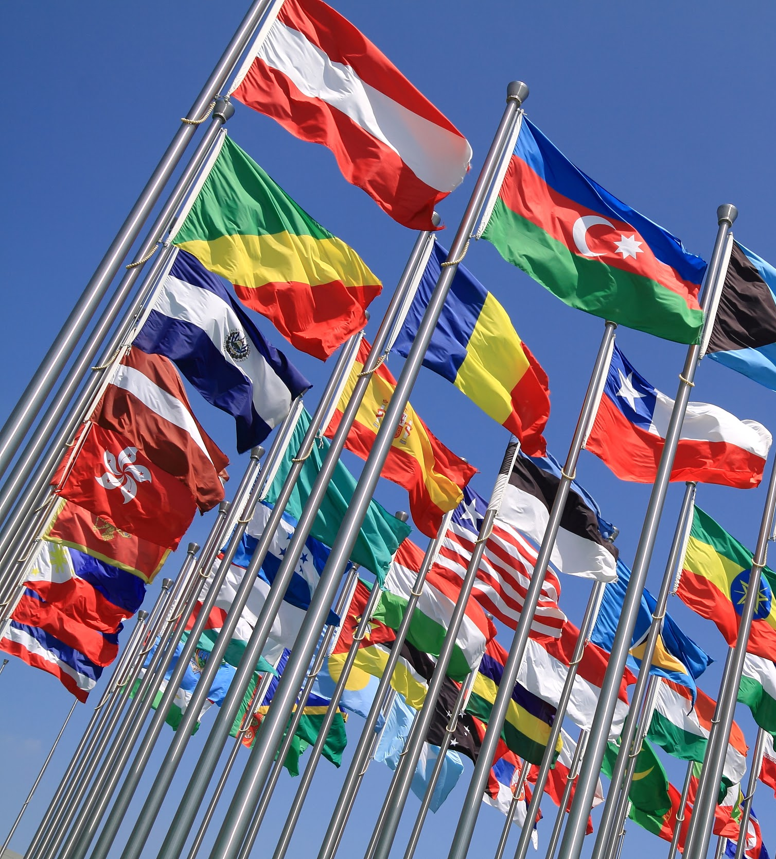
The “Grounder” can take up to 1 HUNDRED PREDICTIONS from Methane and Carbon dioxide to moisture levels.
Tip
Don’t wait till the end of the presentation to give the bottom line.
Reveal your product or idea (in this case a translation app) up front.

Slide 13
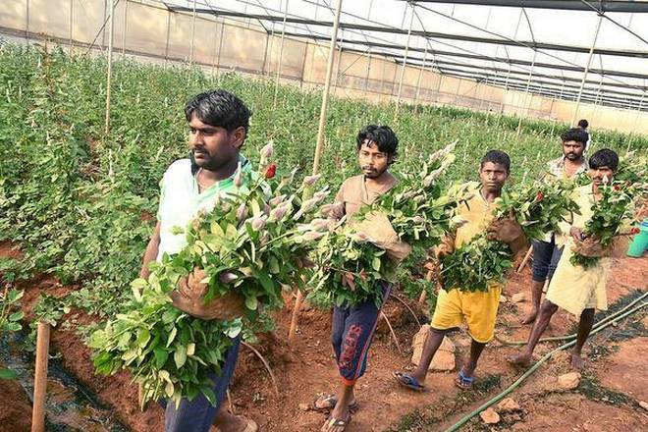
Meet the Bagalurians.
Farmers in Northern Tamil Nadu, India.
Tried to afford the $1000 system, went without it, had to shed their crops worth a month of food on the table.

Slide 14

Shooting Star’s Goals?
-Goal is to be an outreach for education in poor places of countries
-Multi-million dollar industry in sensors, just sells for less than 100 bucks.
Story for illustration purposes only

Slide 15
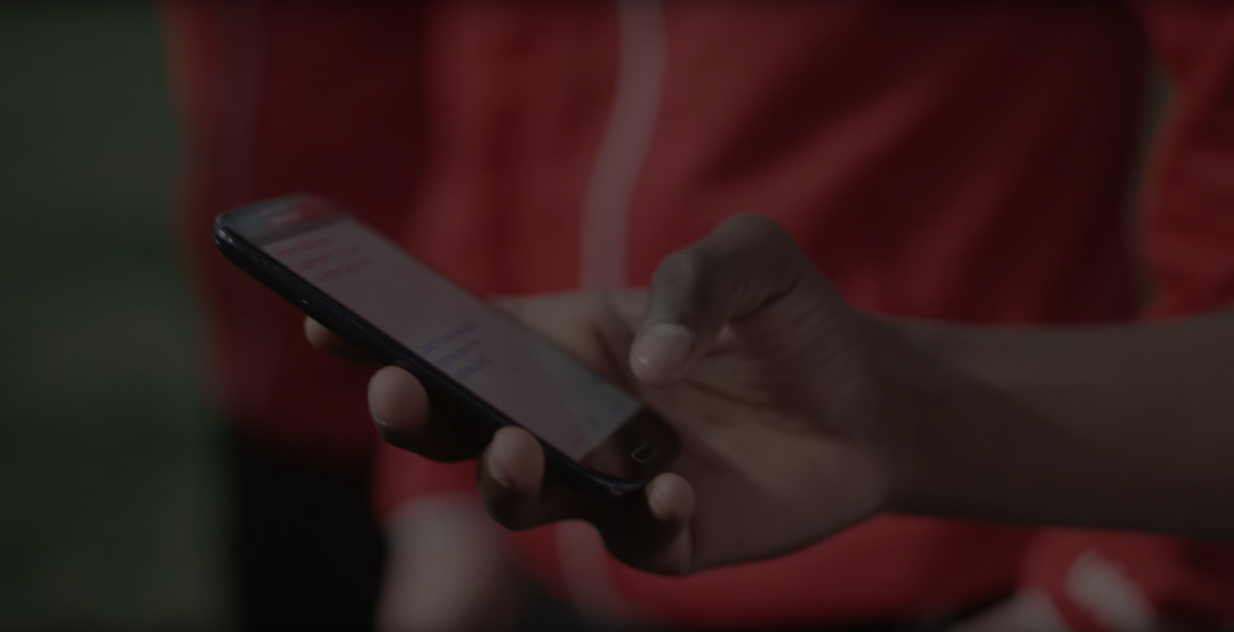
A monetary barrier separates the bagalurians from ideal farming situations.

Slide 16
It’s no surprise the UN has declared a crisis here.
There are OFFICIALLY 500 MILLION RECOGNIZED FARMS in the UN.

Slide 17
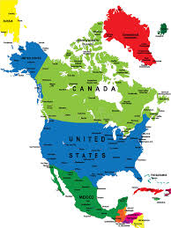
THAT’S ALMOST THE POPULATION OF
NORTH AMERICA
Source: travel.trade.gov

Slide 18

Know of a poor nation that needs this? Make their dreams come true by helping our Tech.

Slide 19
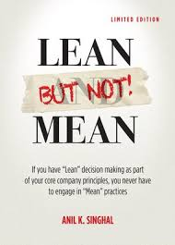
Good luck!
We hope you’ll use these facts to support our venture and help the dreams of a billion people come true;
Any other questions regarding this presentation, or the invention in general?
As Anil Singhal said in LBNM,”Unconsciously practicing [provides]..... a way of seeing the world.”

